Slide 1
CSCI 544 project : Abstractive Text Summarization of Lecture Video Transcripts
Siwei Li, Ronet Swaminathan , Linsheng Ji
Dalya Alqaseer, Haonan Xu
Instructor: Mohammad Rostami, Max Ma

Slide 2
Motivation

Slide 3
Importance of video summarization
Duration is long, hard to grasp the main ideas
Help users to choose the right videos to watch
Existing summarization methods are built for written texts

Slide 4
DATASET AND DEMO

Slide 5
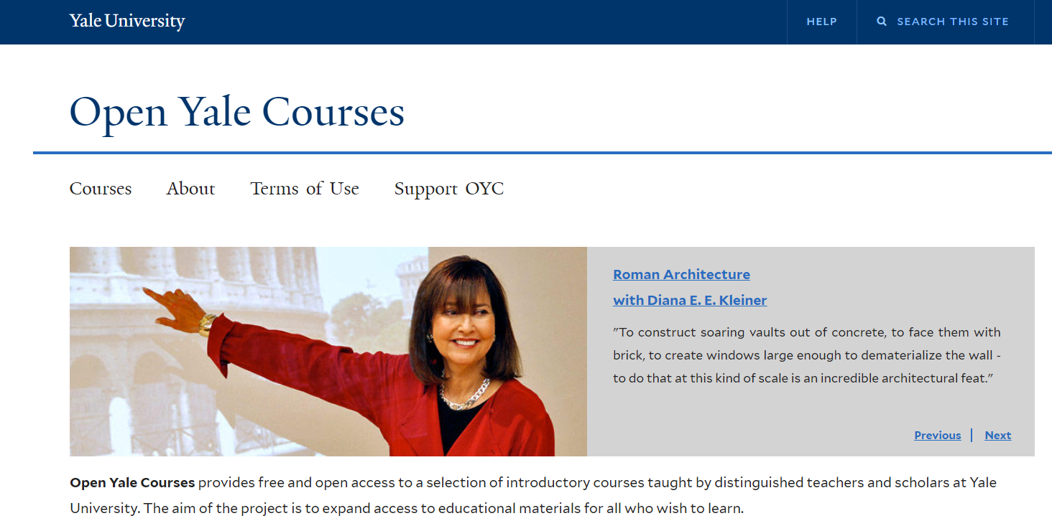

Dataset
Open Yale Courses: 1000+ long transcripts from 41 courses.

Slide 6
MAIN IDEA

Slide 7
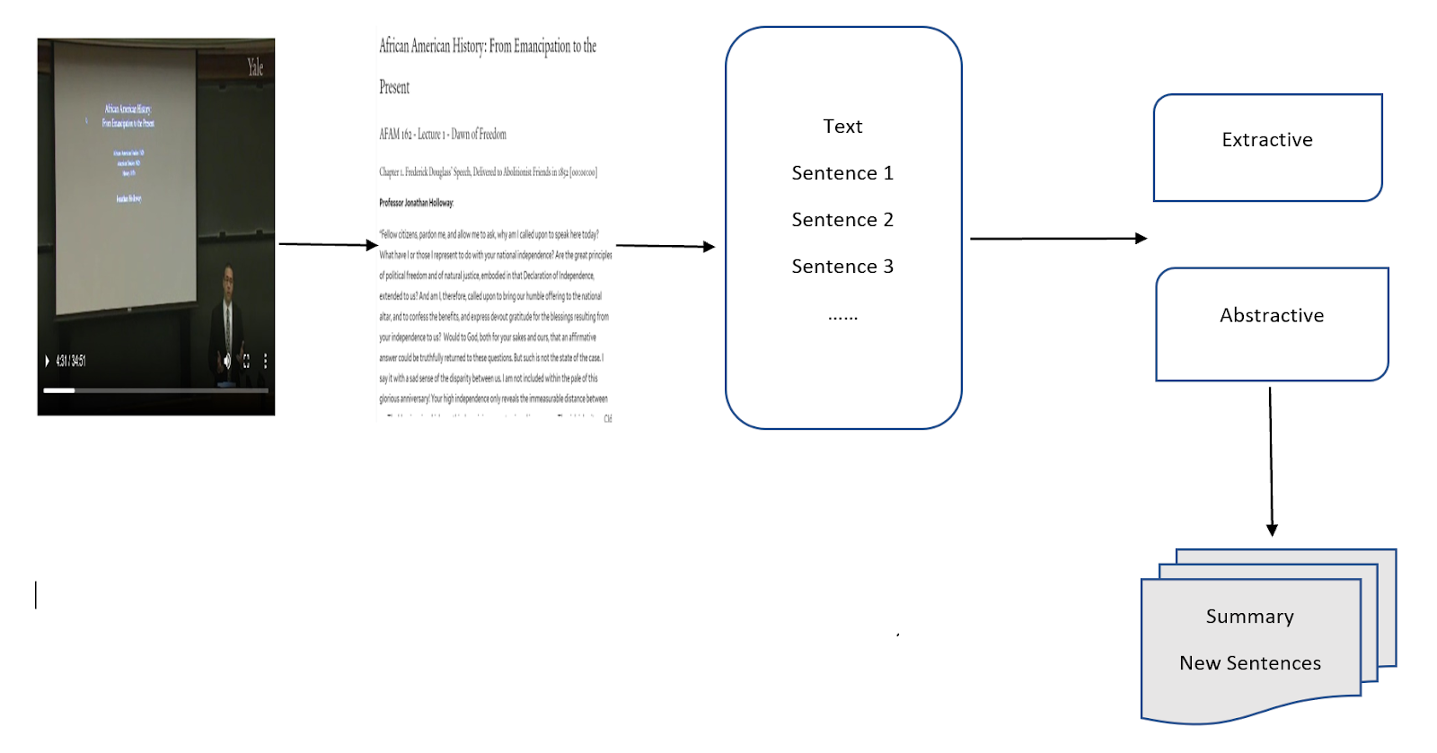
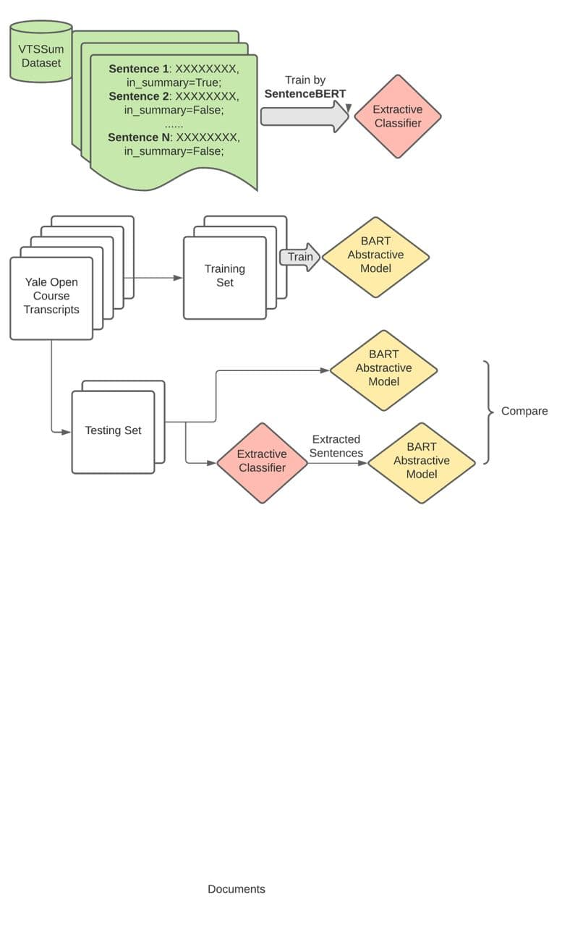
Our pipeline

Slide 8
 | ROUGE1 | ROUGE2 | ROUGE3 | ROUGEL | ROUGELsum
Baseline BART | 0.3384 | 0.0747 | 0.0211 | 0.2034 | 0.2034
Extractive(VTTSum) + Abstractive | 0.3319 | 0.0687 | 0.0207 | 0.2054 | 0.2054
Extractive(Transformers) + Abstractive | 0.3420 | 0.0711 | 0.0228 | 0.2038 | 0.2038

Slide 9
 | BERT-Score-precision | BERT-Score-recall | BERT-Score-f1
Baseline BART | 0.8506 | 0.8545 | 0.8524
Extractive(VTTSum) + Abstractive | 0.8516 | 0.8539 | 0.8527
Extractive(Transformers) + Abstractive | 0.8528 | 0.8558 | 0.8542

